Slide 1
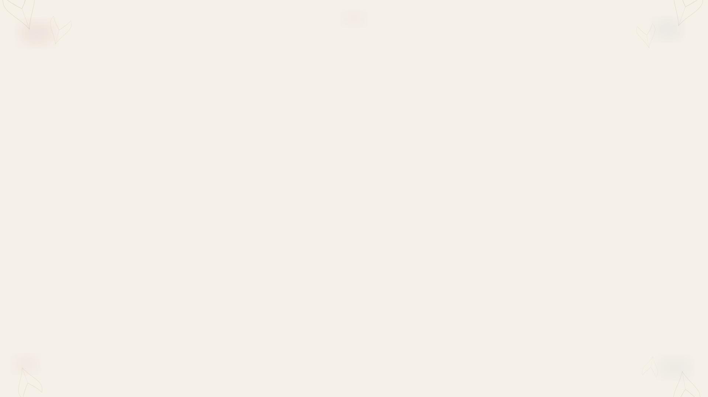
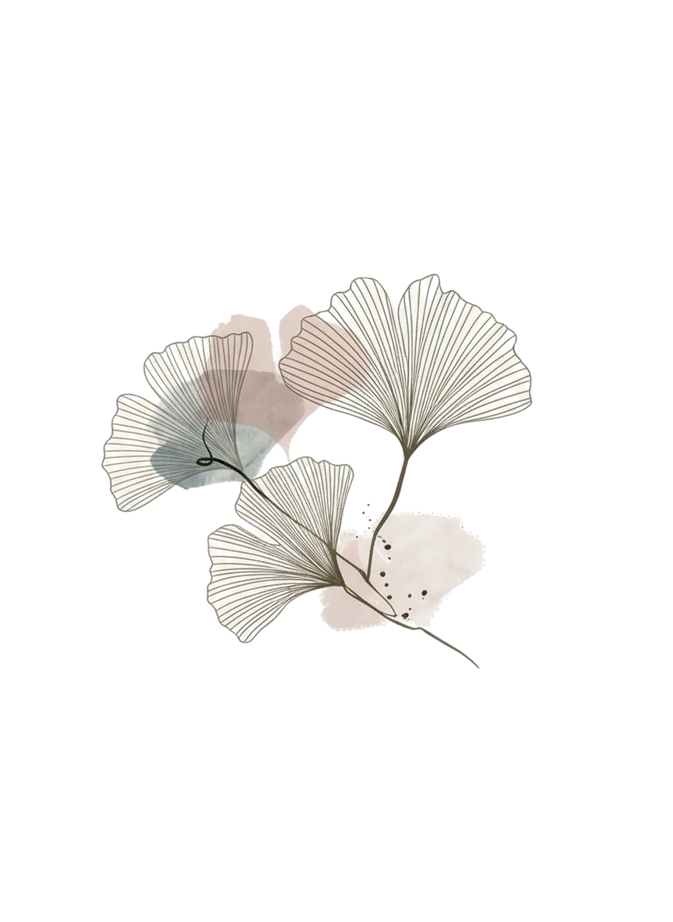
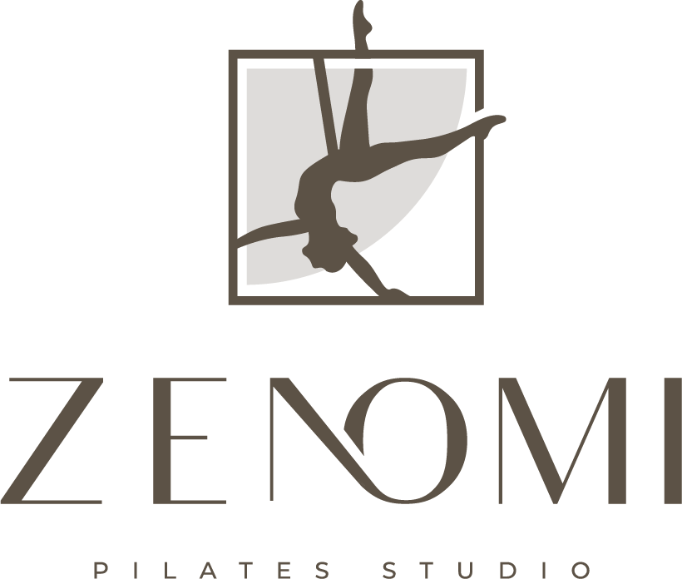
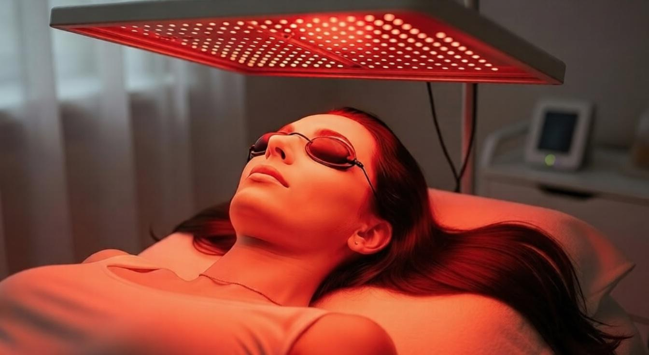
ILLUMINATE
YOUR LONGEVITY

Slide 2
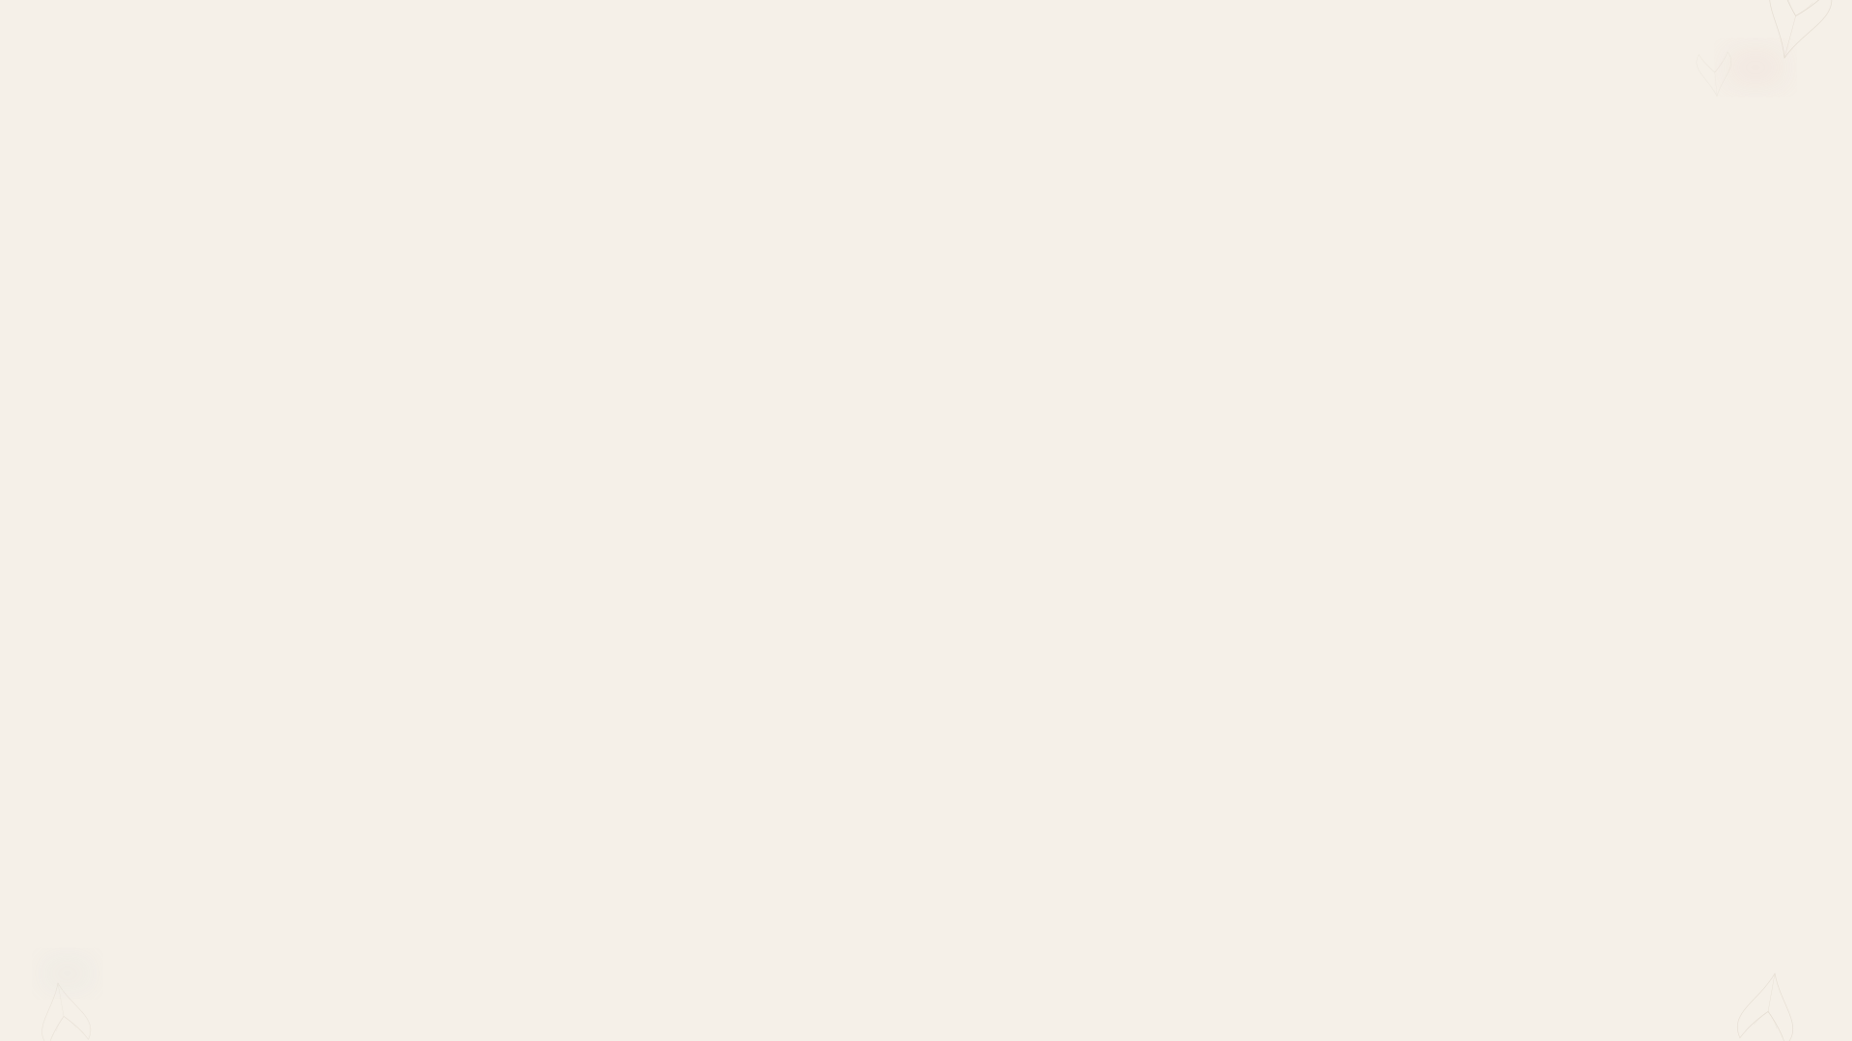
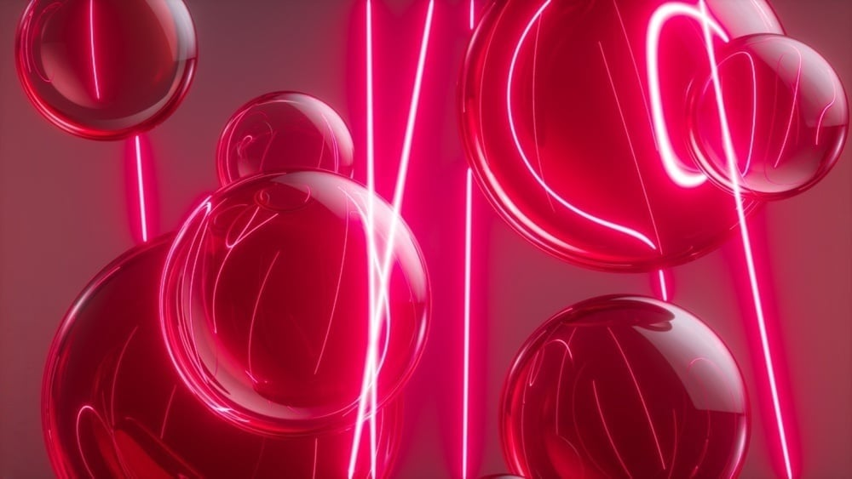


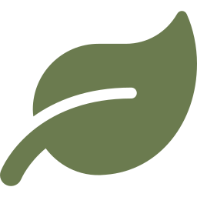
What is Red Light Therapy?
Also known as Photobiomodulation, red light therapy uses specific wavelengths of light (600–900 nm) to energise your cells at a deep level.
How does it work?
Red and near-infrared light is absorbed by mitochondria — your cells' energy factories. This boosts ATP production, enhances repair signals, and reduces oxidative stress.
Your body heals, repairs, and rejuvenates — naturally.
Non-invasive
Safe wavelengths
Natural healing
No needles, no downtime
No UV — no skin damage
Stimulates your body's
own repair processes

Slide 3
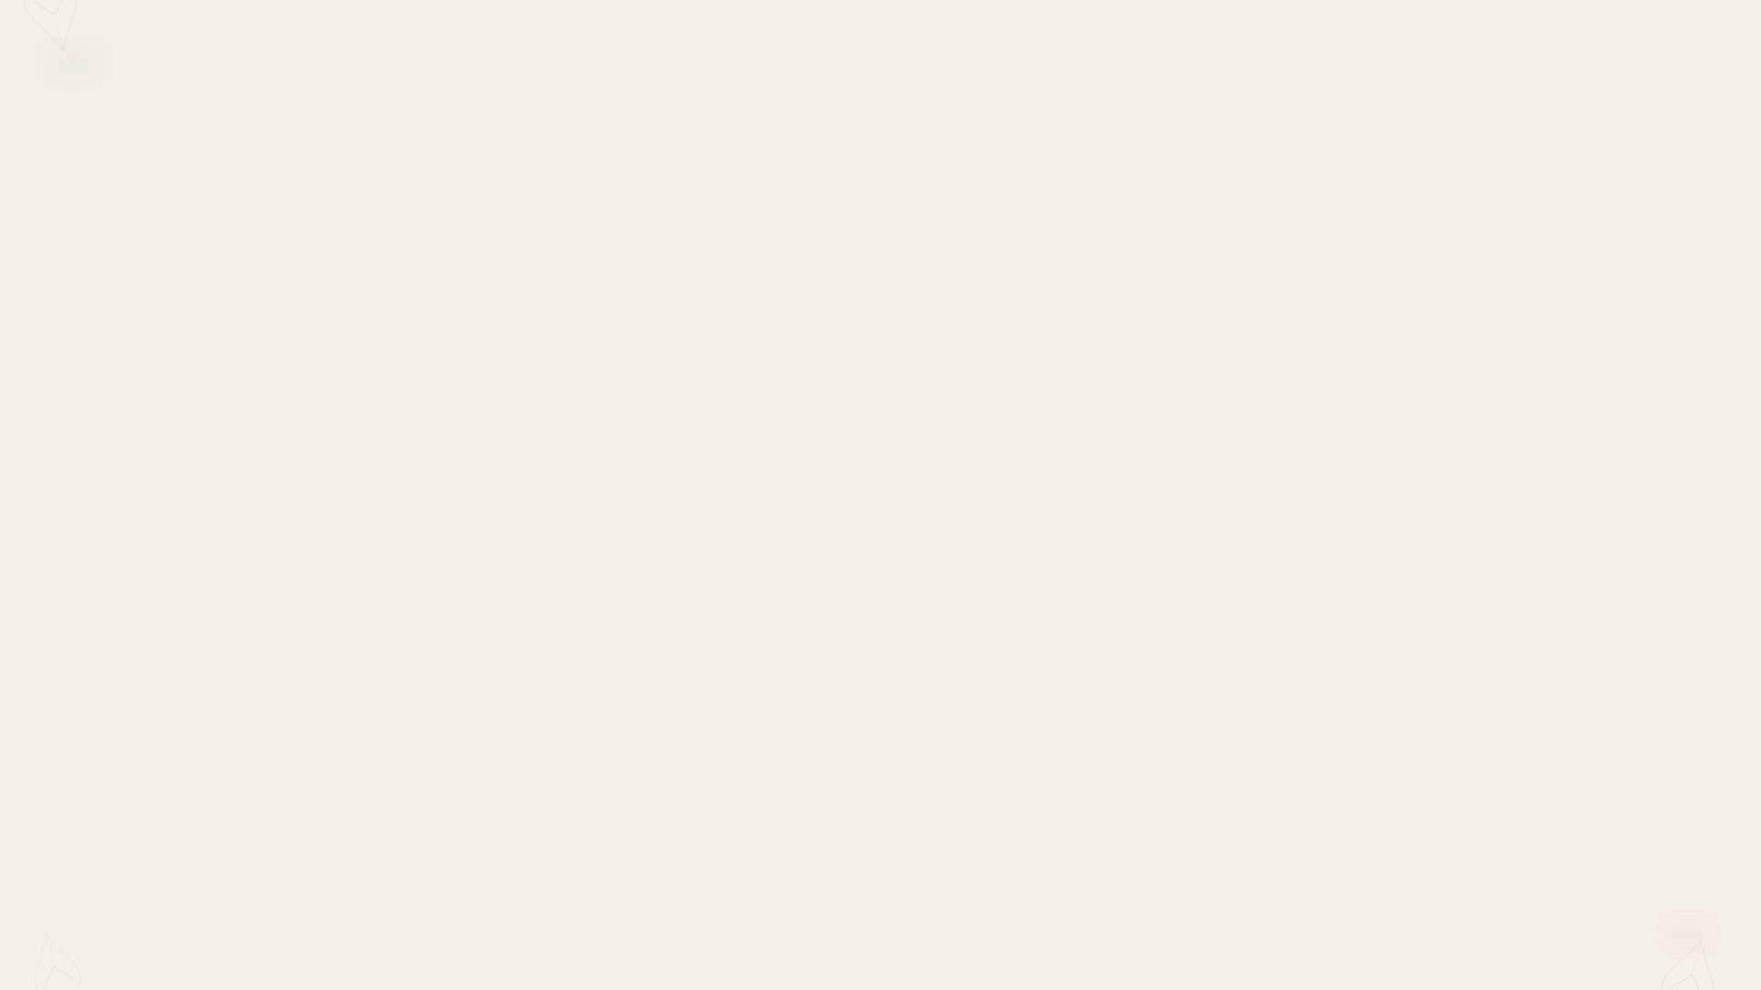
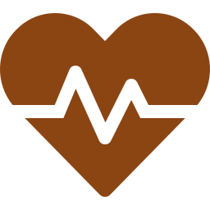
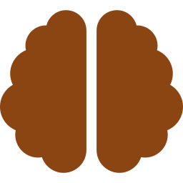
Proven Benefits
Skin Rejuvenation
Pain & Inflammation
Cognitive Support
Stimulates collagen and elastin production, reducing fine lines and improving skin tone and texture
Clinically shown to reduce chronic and acute pain, especially from inflammatory conditions and joint issues
Early research shows promising improvements in memory and cognitive function through brain-targeted treatments
Wound Healing
Muscle Recovery
Cellular Energy
Accelerates skin repair — wounds treated with red light close faster with less pain at the wound site
Helps athletes and active people recover faster by reducing muscle soreness and promoting tissue repair
Boosts mitochondrial ATP production — the fundamental energy currency of every cell in your body

Slide 4
Treatment Programs Overview
Program | Goal | Spectrum | Duration | Pulse | Position
Women's Health | Hormonal balance, uterine & ovarian function | NIR: 760–1060 nm (100%), Red OFF | 20 min | CW | Lower abdomen, 10–15 cm
Deep Sleep | Parasympathetic activation, muscle relaxation | NIR: 760–1060 nm (100%), Red OFF | 10 min | 10 Hz | Lying/sitting, 30–60 min pre-bed
Skin Glow | Collagen, skin renewal, diminish fine lines | Red: 630–760 nm (100%), NIR OFF | 15 min | — | Face, eyes closed, 15–20 cm
Longevity | Cellular energy, all chromophores activated | All 630–1060 nm, full intensity | 20 min | — | Front 10 + back 10 min
Resilience | Post-exertion recovery, reduce fatigue | All wavelengths, 80% intensity | 20 min | — | Target area, 10–20 cm
Brain Boost | Mental clarity, focus, cognitive function | NIR: 760–1060 nm (100%), Red OFF | 15 min | 40 Hz | Forehead, 5–10 cm

Slide 5



Your Red Light Therapy Guide
How often?
What to expect
3–5 sessions per week for best results. Start with 2–3 sessions and gradually build up. Most people notice visible improvements after 3–4 weeks of consistent use.
Week 1–2
Skin feels softer, improved glow and relaxation
Week 3–4
How long per session?
Visible improvements in skin tone and texture
10–20 minutes per treated area. Shorter sessions are fine at first — consistency matters more than duration.
Week 4–8
Reduced fine lines, less inflammation, better recovery
Good to know: Red light therapy follows a biphasic response — the right dose matters. More is not always better. Follow the recommended session length for optimal results.
After 8+ weeks
Lasting results — switch to 1–2x/week maintenance

Slide 6

The Science Behind It
2025 Consensus Review
20+ specialists confirmed red light therapy is safe and effective for wound healing, neuropathy, and pattern hair loss.
Maghfour et al., J. Am. Acad. Dermatol. (2025)
Skin Rejuvenation Trial
136 volunteers showed significant improvements in skin complexion, wrinkle reduction, and collagen density after 30 sessions.
Wunsch & Matuschka, Photomed. Laser Surg. (2014)
Wound Healing (2024)
Red/infrared light significantly accelerates wound healing. Treated wounds closed faster with less pain.
Taha et al. — meta-analysis, 18 randomised trials
Pain & Inflammation
Significant improvements in chronic pain associated with arthritis, inflammation, and musculoskeletal conditions.
Multiple studies reviewed by UCLA Health
FDA Recognition
Approved first red-light device for dry age-related macular degeneration. Multiple devices cleared for skin ageing.
U.S. Food & Drug Administration (2024)

Slide 7

Experience It at Zenomi
Discover the future of recovery and
mitochondrial health.
Red Light Therapy Evening
Date: April 9th, 2026 | 6:30 PM
Zenomi, Baarerstrasse 86, 6300 Zug

