Slide 1



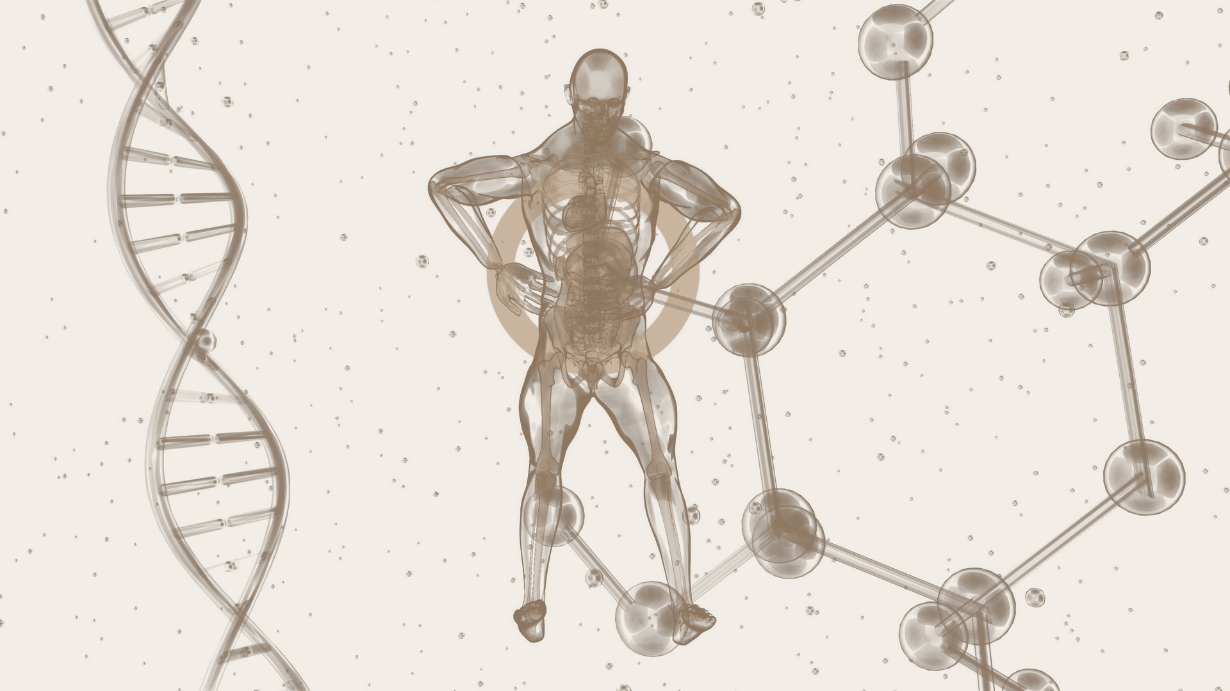
KNOW YOUR
BIOMARKERS
7 tests your doctor won't order — but you should ask for
Based on educational content by Dr. med. Asmira Husić Mulabećirović · biologijatrajanja.com

Slide 2



Why this matters
"Time can't be bought. Longevity is trained."
7
biomarkers
every adult should know
The Western preventive system is built to put out fires — not to stop them.
Standard annual blood panels confirm what's already wrong. They rarely catch the silent processes — arterial inflammation, insulin resistance, vascular ageing — that begin 10 to 20 years before any symptom appears.
These seven markers shift the question from "am I sick?" to "how is my biology actually ageing?"
10–20
years earlier
than most diagnoses arrive
Evidence-based
Practical
Educational
ESC / EAS clinical guidelines
ICD codes, prices, lab partners
Not a substitute for medical advice
Zenomi · Know Your Biomarkers
01

Slide 3
The 7 biomarkers — at a glance
Each maps a different ageing pathway. None of these is part of a standard annual check-up.
#
Marker
What it tracks
Optimal target
Pathway
1
ApoB
Number of artery-clogging particles
< 80 mg/dL
Cardiovascular
2
Lp(a)
Genetic, lifelong cardiovascular risk
< 30 mg/dL
Genetic
3
hs-CRP
Silent, low-grade systemic inflammation
< 1.0 mg/L
Inflammation
4
HbA1c
Average blood sugar over 2–3 months
< 5.4 %
Metabolic
5
Homocysteine
B-vitamin metabolism, vascular & brain
< 9 µmol/L
Methylation
6
Vitamin D
Immune, hormonal, mood & bone signalling
50–80 ng/mL
Hormonal
7
TG/HDL ratio
Insulin resistance from a standard panel
< 1.5
Metabolic
Zenomi · Know Your Biomarkers
02

Slide 4




1
BIOMARKER
ApoB
Apolipoprotein B · the cardiovascular particle count
What it measures
Why it matters
Apolipoprotein B is the structural protein carried by every artery-clogging particle in the blood — LDL, VLDL, IDL and Lp(a). One ApoB molecule per particle. So an ApoB measurement is, quite literally, a count of how many bad particles you have in circulation.
Standard LDL cholesterol measures only the cholesterol carried inside those particles — not the particle count. The INTERHEART study (≈30,000 people, 52 countries) found the ApoB/ApoA1 ratio outperformed both LDL and total cholesterol as a predictor of heart attack. You can have a 'normal' LDL and still carry far too many small, dense, dangerous particles.
Target values
If elevated — what to do
Range
Value
Meaning
Mediterranean-style eating: more fibre + omega-3, fewer saturated and trans fats
150 min/week aerobic + 2× resistance training (every kg lost reduces particle count)
Stop smoking; control blood pressure and blood sugar
Statins (–30 to –50%), ezetimibe or PCSK9-inhibitors — under medical supervision
Lab 'normal'
< 100–130
what most reports flag
Optimal
< 80 mg/dL
healthy adult target
Aggressive
< 60 mg/dL
for high-risk patients
Zenomi · Know Your Biomarkers
03

Slide 5

2
BIOMARKER
Lp(a)
Lipoprotein(a) · the genetic cardiovascular wildcard
What it measures
Why it matters
Lp(a) is an LDL-like particle wrapped in an extra protein, apolipoprotein(a). Its level is set almost entirely by genetics — diet, exercise and conventional cholesterol drugs barely move it. Because it's stable across a lifetime, you only ever need to measure it once.
Lp(a) is one of the strongest independent genetic risk factors for heart attack, stroke, aortic stenosis and clot formation — and most doctors never test for it. Roughly one in five adults carries levels above 50 mg/dL. The 2022 ESC/EAS guidelines now recommend that every adult have it measured at least once.
Target values
If elevated — what to do
Range
Value
Meaning
It cannot be 'fixed' by lifestyle — this is genetics, not a personal failing
Aggressively control everything else: LDL to a minimum, blood pressure, glucose, smoking
PCSK9-inhibitors can lower Lp(a) by 20–30%
Emerging therapies (antisense, siRNA) currently in clinical trials
Optimal
< 30 mg/dL
no extra genetic risk
Grey zone
30–50 mg/dL
watch in context
Elevated
> 50 mg/dL
meaningfully raised risk
Very high
> 180 mg/dL
specialist follow-up
Zenomi · Know Your Biomarkers
04

Slide 6

3
BIOMARKER
hs-CRP
High-sensitivity C-reactive protein · the silent inflammation marker
What it measures
Why it matters
hs-CRP detects very low, chronic levels of systemic inflammation — the 'silent fire' that smoulders for years without symptoms while quietly accelerating atherosclerosis and cognitive decline. It's the same molecule as standard CRP, just measured at far higher sensitivity.
The JUPITER trial showed that people with normal LDL but elevated hs-CRP (> 2 mg/L) carried significantly higher cardiovascular risk — and that statins reduced their event rate even when their cholesterol looked fine. hs-CRP also tracks risk for diabetes, stroke, dementia and all-cause mortality.
Target values
If elevated — what to do
Range
Value
Meaning
Anti-inflammatory eating: omega-3 (fatty fish, flax), fewer refined carbs and trans fats
Regular aerobic + strength training; lose body fat (adipose tissue is an inflammatory organ)
Sleep quality matters — poor sleep raises inflammatory markers measurably
Stop smoking; under medical supervision: statins, sometimes colchicine in high-risk patients
Low risk
< 1.0 mg/L
optimal target
Moderate
1.0–3.0 mg/L
act on lifestyle
High
> 3.0 mg/L
evaluate and intervene
Acute
> 10 mg/L
rule out infection / autoimmune
Zenomi · Know Your Biomarkers
05

Slide 7

4
BIOMARKER
HbA1c
Glycated haemoglobin · your 3-month sugar average
What it measures
Why it matters
HbA1c reflects your average blood-sugar level over the previous two to three months. Where a fasting glucose only captures one moment, HbA1c gives you a moving picture of how your metabolism handles sugar over time.
This is not just a diabetic's test — it's a prevention tool for everyone. Pre-diabetes goes unrecognised for years and is linked to higher rates of heart disease, stroke, dementia and cancer, even when fasting glucose looks normal. Risk begins climbing above 5.4%, well below the standard pre-diabetes cutoff.
Target values
If elevated — what to do
Range
Value
Meaning
Cut refined carbs and added sugars — bread, pasta, juices, sweets
Build meals around vegetables, whole grains, healthy fats, olive oil, nuts
150 min/week of aerobic activity — walking counts
5–10% weight loss markedly improves insulin sensitivity
Metformin only on medical advice, in diabetes or very high risk
Optimal
< 5.4 %
prevention target
Watch zone
5.4–5.6 %
tighten lifestyle
Pre-diabetes
5.7–6.4 %
active intervention
Diabetes
≥ 6.5 %
diagnosis & treatment
Zenomi · Know Your Biomarkers
06

Slide 8

5
BIOMARKER
Homocysteine
An amino acid that signals B-vitamin status
What it measures
Why it matters
Homocysteine is an amino acid produced when the body breaks down methionine. Elevated levels point to a disturbance in how you metabolise B12, B6 and folate — and signal that core biochemical pathways protecting your blood vessels and brain aren't running cleanly.
High homocysteine directly damages the inner lining of blood vessels, accelerates atherosclerosis, and raises risk for heart attack, stroke, thrombosis and osteoporosis. It's also one of the most consistent biomarkers found in Alzheimer's and vascular dementia. Especially relevant for older adults, vegetarians/vegans, kidney or liver disease, and long-term metformin users.
Target values
If elevated — what to do
Range
Value
Meaning
Folate: dark leafy greens (spinach, kale, broccoli), lentils, beans
Vitamin B6: fish, poultry, bananas, potatoes
Vitamin B12: meat, eggs, dairy — vegans/vegetarians must supplement
Active-form B-complex (methylfolate, methyl-B12) only with a clinician
Treat root causes: malabsorption, kidney/liver disease, medications that deplete B12
Optimal
< 9 µmol/L
prevention target
Lab 'normal'
9–15
watch zone
Moderate
15–30
moderate hyperhomocysteinaemia
Severe
> 30
urgent evaluation
Zenomi · Know Your Biomarkers
07

Slide 9

6
BIOMARKER
Vitamin D (25-OH)
25-hydroxyvitamin D · the only reliable status marker
What it measures
Why it matters
25-hydroxyvitamin D is the main circulating form of vitamin D — and the only reliable measure of your overall vitamin D status. The active form (1,25-OH₂) fluctuates too quickly to be useful clinically.
Vitamin D is far more than a bone vitamin: receptors sit on virtually every tissue — immune cells, brain, heart, muscle, pancreas, thyroid. Deficiency tracks with autoimmunity, cardiovascular disease, type 2 diabetes, depression, cognitive decline and certain cancers. In Central Europe, more than 60% of adults are deficient in winter. Lab 'normal' (>20 ng/mL) only prevents rickets — it isn't an optimum.
Target values
If elevated — what to do
Range
Value
Meaning
Sun: 10–30 min on arms and face, no sunscreen, outside the 12–3 PM peak
Food: oily fish (salmon, sardines, mackerel), eggs, shiitake, fortified products
Supplement: D3 (cholecalciferol) 2,000–4,000 IU/day maintenance; up to 6,000–10,000 IU/day to correct deficit — with medical supervision
Pair with K2 (mk-7) and magnesium for absorption
Re-test after 3–4 months of supplementation
Deficient
< 20 ng/mL
serious lack
Insufficient
20–30
still inadequate
Adequate (bone)
30–50
lab 'normal'
Optimal
50–80 ng/mL
immune, brain, hormonal
Zenomi · Know Your Biomarkers
08

Slide 10

7
BIOMARKER
TG / HDL ratio
Triglycerides ÷ HDL · the free insulin-resistance signal
What it measures
Why it matters
The TG/HDL ratio is a simple division — your triglycerides divided by your HDL cholesterol. It costs nothing extra: anyone who has ever done a lipid panel already has the two numbers needed. Most labs and most doctors don't compute it.
It's the cleanest, simplest surrogate marker for insulin resistance — the metabolic state that precedes type 2 diabetes by 10–15 years and quietly accelerates atherosclerosis. A high ratio also flags small, dense LDL particles ('Pattern B'), which slip into arterial walls more easily. Powerful for people with normal LDL but hidden metabolic dysfunction (PCOS, fatty liver, family history of diabetes, sedentary lifestyle).
Target values
If elevated — what to do
Range
Value
Meaning
Cut refined carbs and added sugar — the single biggest lever for triglycerides
Mediterranean pattern: olive oil, nuts, fish, vegetables, moderate whole grains
Aerobic + strength training; aim for 5–10% body-weight loss
Stop smoking; reduce alcohol (alcohol significantly raises triglycerides)
Omega-3, berberine, magnesium can help; fibrates only with a clinician for very high TG
Ideal
< 1.0 (mg/dL)
best metabolic profile
Good
1.0–1.5
optimal target
Borderline
1.5–3.0
watch closely
High risk
> 3.0
metabolic dysfunction
Zenomi · Know Your Biomarkers
09

Slide 11
Optimal targets — at a glance
Print this page. Compare it to your last lab results. Anything in the right column should be discussed with your doctor.
ApoB
Lp(a)
hs-CRP
HbA1c
< 80
< 30
< 1.0
< 5.4
mg/dL
mg/dL
mg/L
%
particle count
lifelong risk
silent inflammation
blood-sugar avg
Homocysteine
Vitamin D
TG / HDL
< 9
50–80
< 1.5
µmol/L
ng/mL
ratio
B-vitamin status
immune & hormonal
insulin resistance
Zenomi · Know Your Biomarkers
10

Slide 12


How to talk to your doctor
Most of these markers aren't routinely covered by public insurance — but the full panel privately costs less than a tank of fuel.
A simple request you can bring to your appointment
Bring a printed list
Doctors get 5–7 minutes per patient. A clear written request gets you further than improvising at the desk.
Dear Doctor,
I'd like to ask for the following tests as part of a preventive cardiometabolic screen:
1. ApoB (Apolipoprotein B)
2. Lp(a) — Lipoprotein(a)
3. hs-CRP (high-sensitivity)
4. HbA1c (glycated haemoglobin)
5. Homocysteine
6. 25-OH vitamin D
7. TG/HDL ratio (from a standard lipid panel)
I understand some are not routinely covered, and I'm happy to pay privately. The request is based on the 2021 ESC/EAS guidelines for cardiovascular prevention and the 2024 ESC update.
Be specific about why
Family history, age, lifestyle, fatigue or a recent event in someone close — give them a reason to take it seriously.
It's your data
If insurance won't cover a test, private labs in your region run all 7 markers. You're allowed to know your own biology.
Zenomi · Know Your Biomarkers
11

Slide 13
Train Your Longevity
Knowing these seven numbers is the first move from reactive medicine to actual prevention.
Continue the conversation at Zenomi
7 Biomarkers · 1 Conversation · A different question to ask of your own body
Zenomi Pilates Studio · Baarerstrasse 86, 6300 Zug
Adapted from educational content by Dr. med. Asmira Husić Mulabećirović · biologijatrajanja.com
Educational only — not a substitute for individual medical advice.

